Slide 1
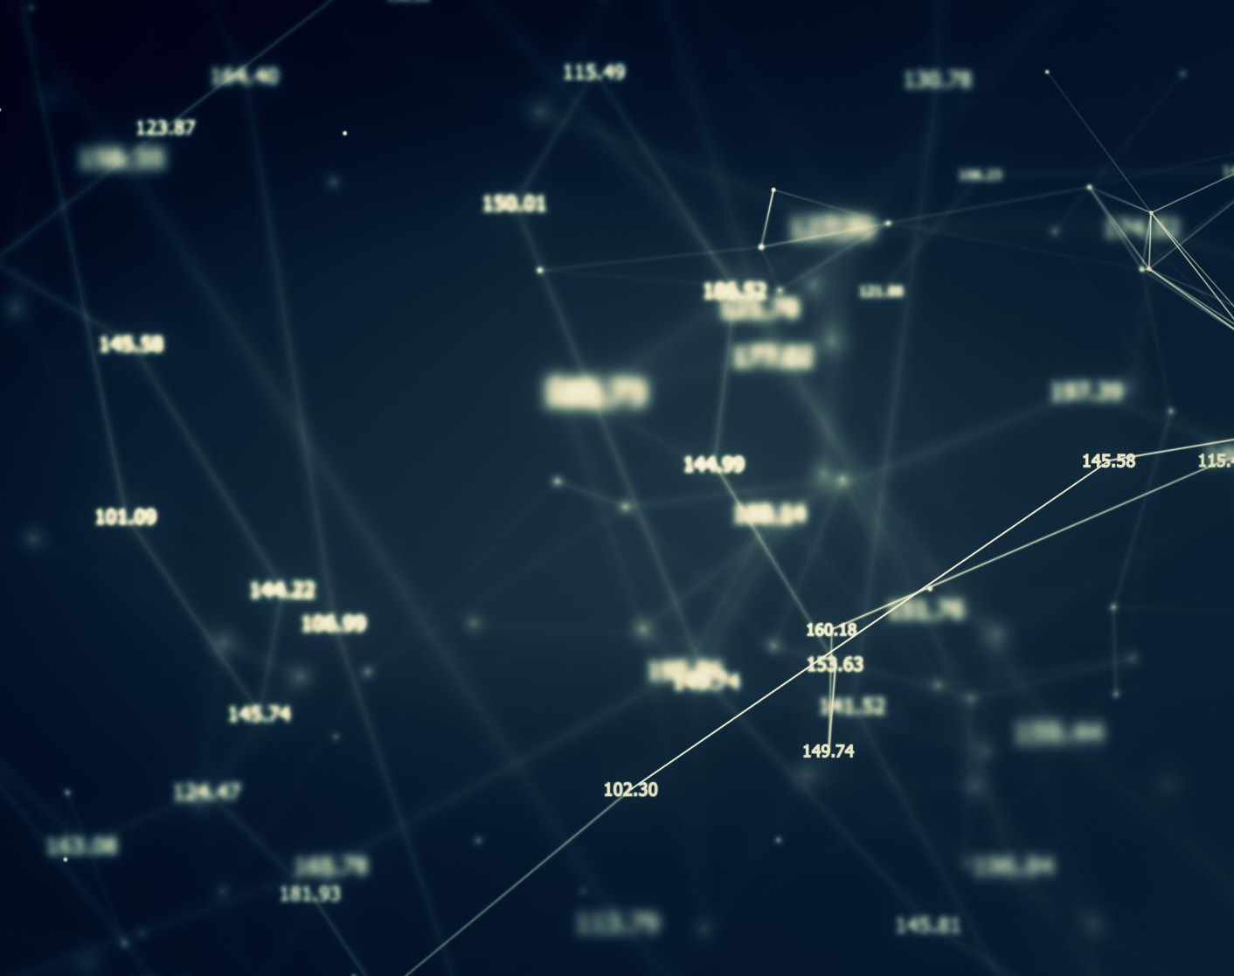
Review of current AI’s

Slide 2

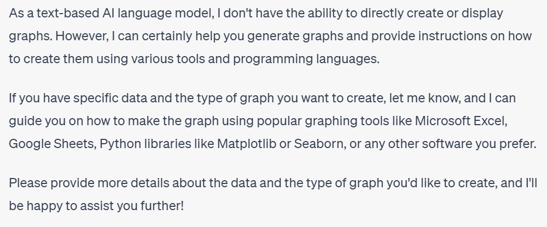
ChatGPT
Given data, can produce graphs but relies on 3rd party software
Limit on data input and output
Summarisation of data is very weak
Can write code very well
e.g. Python and LaTeX
Convincingly fakes data

Slide 3
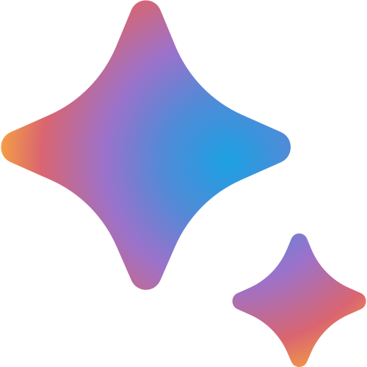
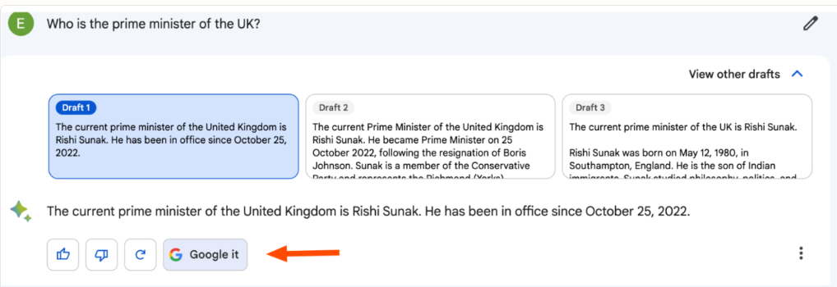
Google Bard
An equivalent to ChatGPT, but can access the internet
Summarize articles and web pages
Better at text summarisation and mathematics
Brainstorm and generate content ideas
Write taglines and short descriptions for inspiration
Compare research and data in a chart
BardAPI ‘available’ but not all users can access Bard
Convert an image containing a formula to corresponding LaTeX code

Slide 4

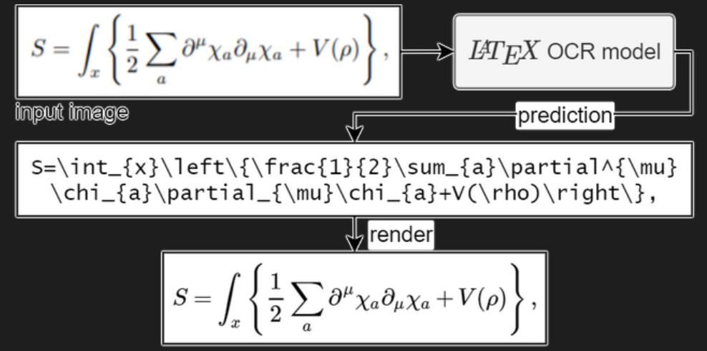
LaTeX OCR
Convert an image containing a formula to corresponding LaTeX code
Due to being open source, can easily be embedded into a larger Python project

Slide 5
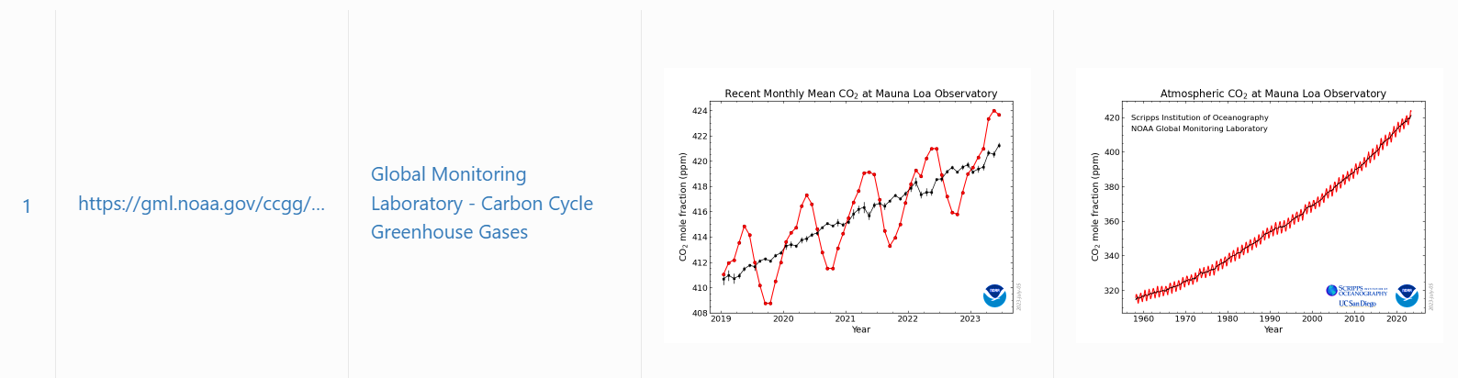

AnyPicker
A.I. powered no code web scraper
Free web data scraper
AI pattern recognition
Works with any website
Can export Excel and CSV format
Can download images
Browser extension

Slide 6

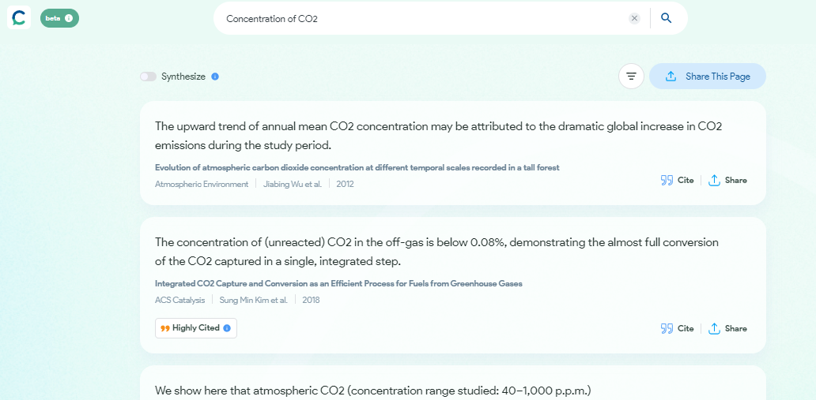
Consensus
Information accurately taken solely from research papers
Can save time in searching for data in academic reports
Hard to embed into Python project

Slide 7

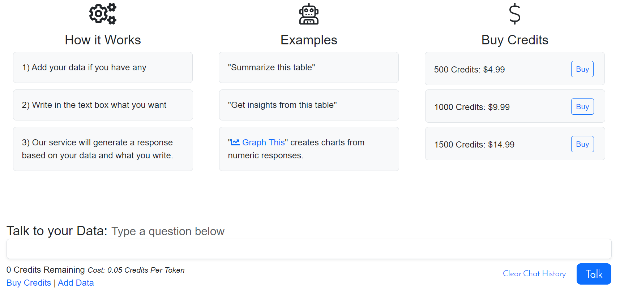
ChartGPT
Can generate charts/graphs from large datasets
Not free to use
Particularly useful

Slide 8
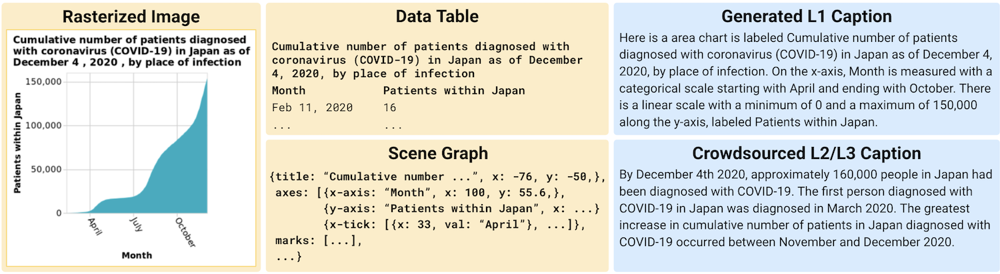
Vistext
Takes a graph/table as input
Generates text describing trend, anomalies etc.
Open source so easy to put into larger Python project

Slide 9

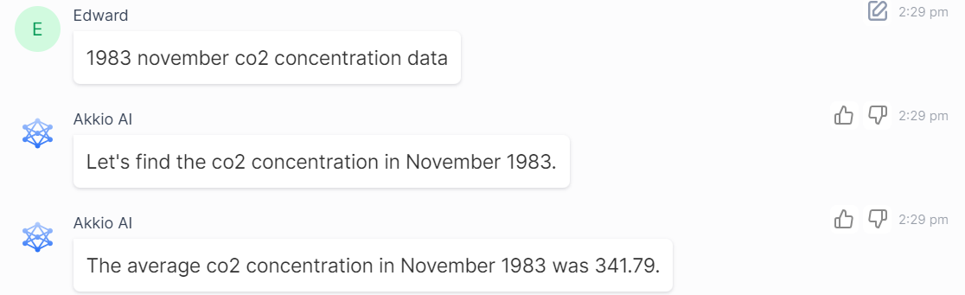
Akkio
Input multiple large data sheets (e.g. Excel, csv – formatting can cause issues)
AI can be asked for any specific values
Can produce forecast data

Slide 10


Appypie
AI App Generator to help generate an app quickly (without coding knowledge)
Text input –> App output
Can easily create an Android app and an iOS app
Many alternatives exist but they all usually require some form of payment

Slide 11

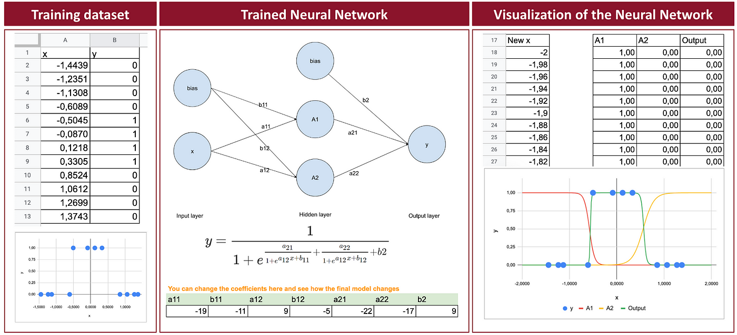
Excel
Still a very competitive data analysis tool
Easy to process data, can create multiple visualisations
Can create machine learning models
Can use formulas to calculate data from clusters
Can create quite complex neural networks

